Slide 1
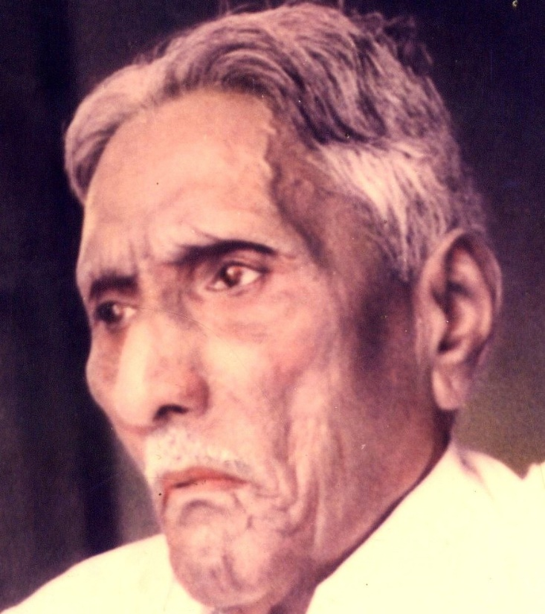

The Bible Mission The Revelation of God to St. M. Devadas The Bible Mission’s Annual Conference

Slide 2
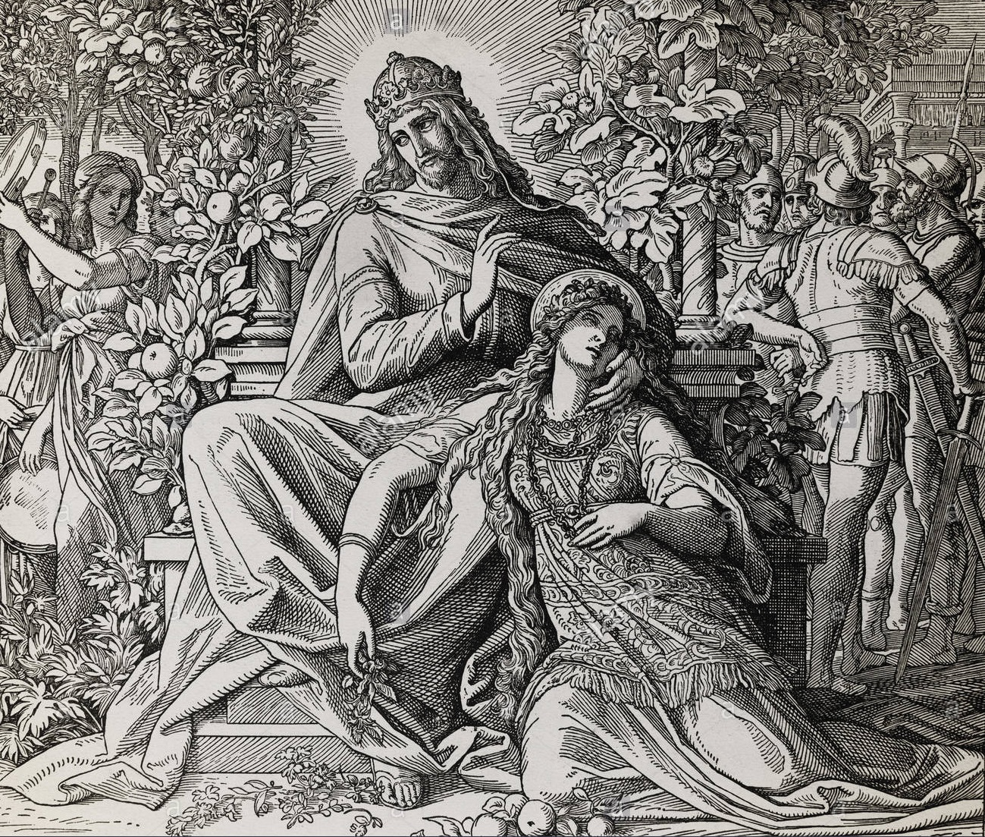
Persecution : The Perfection of Bride The Persecuted Bride in the song of Solomon

Slide 3
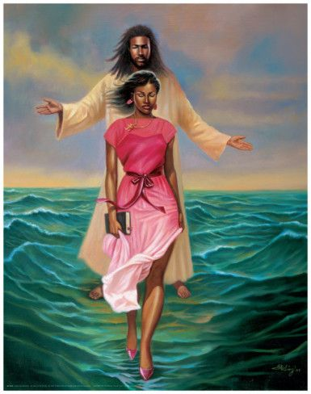
1.Complexion, Confrontation (1:5)
Dark am I, yet lovely, O daughters of Jerusalem,
dark like the tents of Kedar, like the tent curtains of Solomon(1:5)

Slide 4
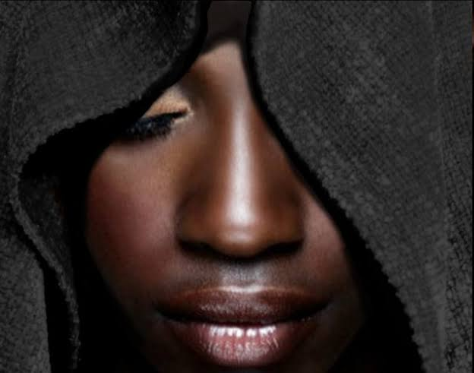
2.Rejection, Repatriation (1:6)
Do not stare at me because I am dark, because I am darkened by the sun. My mother's sons were angry with me and made me take care of the vineyards; my own vineyard I have neglected.(1:6)

Slide 5

3.Veil and travail (1:7)
Tell me, you whom I love, where you graze your flock and where you rest your sheep at midday. Why should I be like a veiled woman beside the flocks of your friends? (1:7)

Slide 6
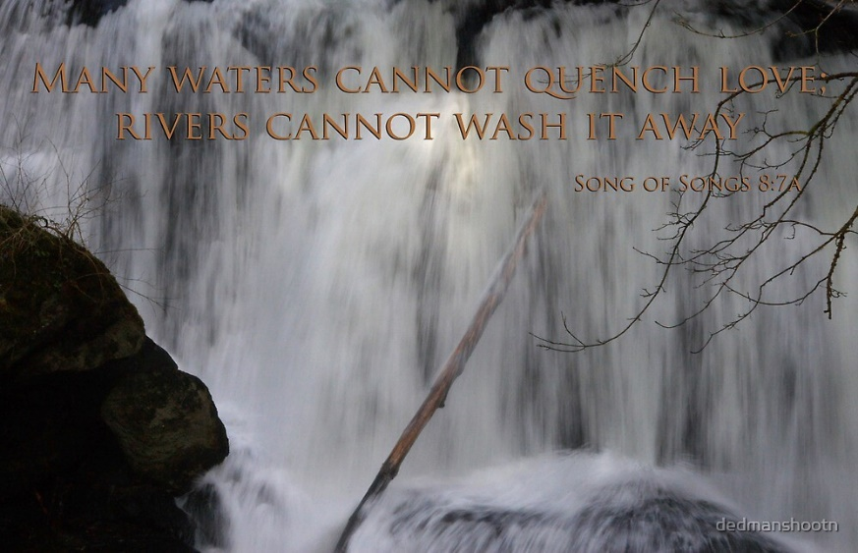
4.Scorn and Scoff (8:7) (8:1) ;
Many waters cannot quench love; rivers cannot wash it away. If one were to give all the wealth of his house for love, it would be utterly scorned.(8:7)
If only you were to me like a brother, who was nursed at my mother's breasts! Then, if I found you outside, I would kiss you, and no one would despise me. (8:1)

Slide 7
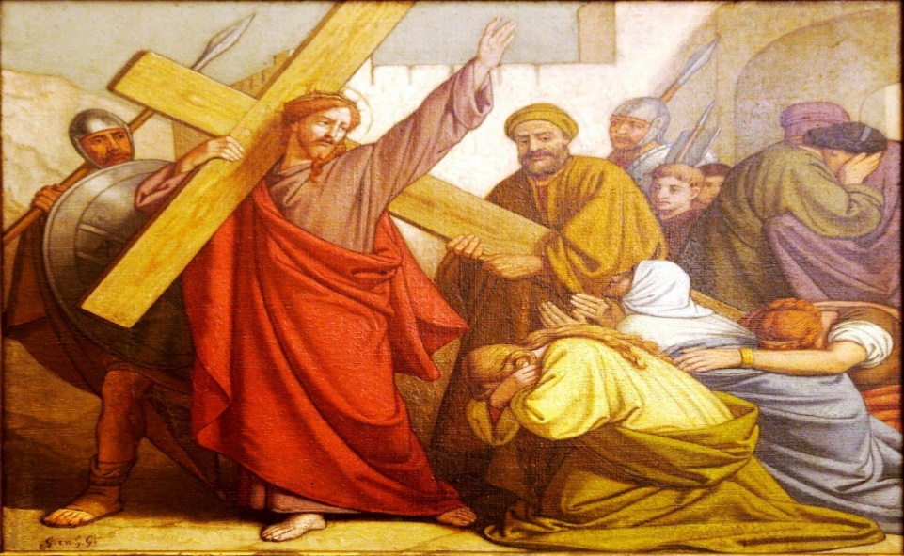
5.Disturbance caused by the daughters of Jerusalem (2:7)
Daughters of Jerusalem, I charge you by the gazelles and by the does of the field: Do not arouse or awaken love until it so desires.(2:7)

Slide 8

6.The wall of obstruction (2:9)
My lover is like a gazelle or a young stag. Look! There he stands behind our wall, gazing through the windows, peering through the lattice.(2:8)

Slide 9
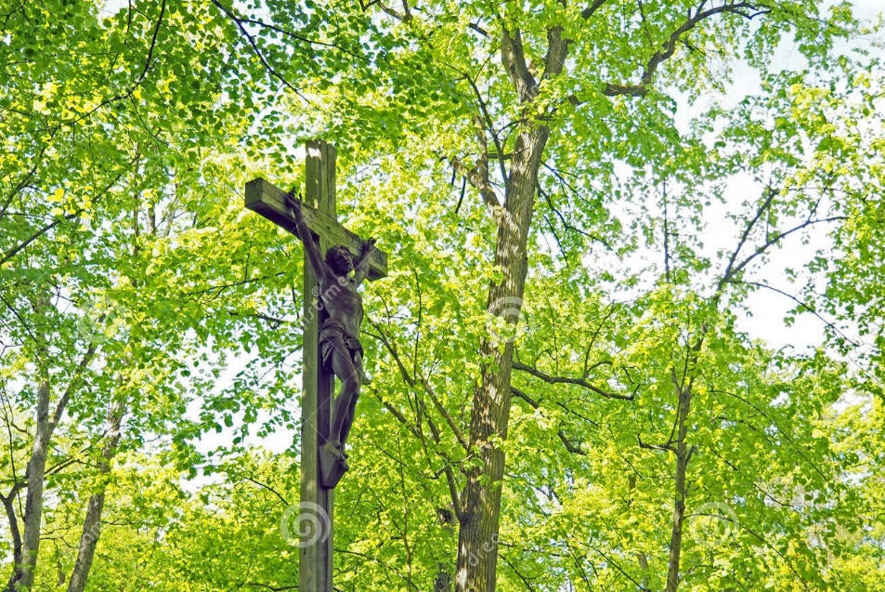
7.The season of stagnation (2:11)
See! The winter is past; the rains are over and gone.(2:11)

Slide 10
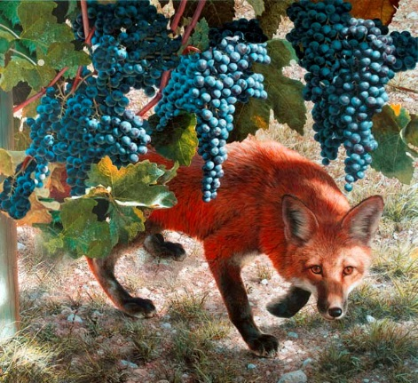
8.The roots of destruction (Foxes and small foxes) (2:15)
Catch for us the foxes, the little foxes that ruin the vineyards, our vineyards that are in bloom(2:15)

Slide 11
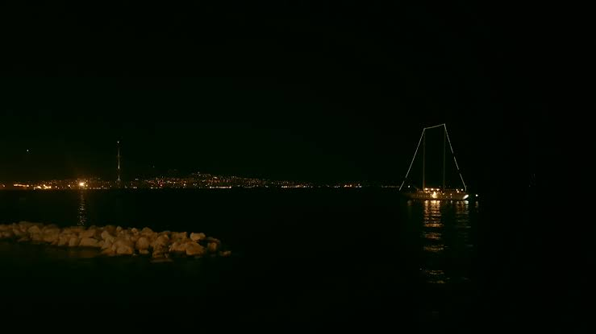
9.The slumbers of night (3:1) (5:2);
All night long on my bed I looked for the one my heart loves; I looked for him but did not find him.(3:1)
I slept but my heart was awake. Listen! My lover is knocking: "Open to me, my sister, my darling, my dove, my flawless one. My head is drenched with dew, my hair with the dampness of the night.“(5:2)

Slide 12
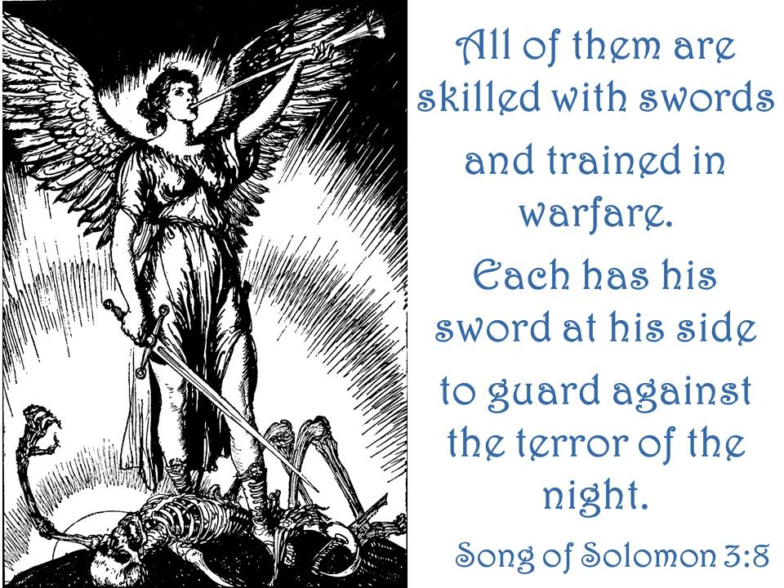
10.The scares of night (3:8)
All of them wearing the sword, all experienced in battle, each with his sword at his side, prepared for the terrors of the night. (3:8)

Slide 13
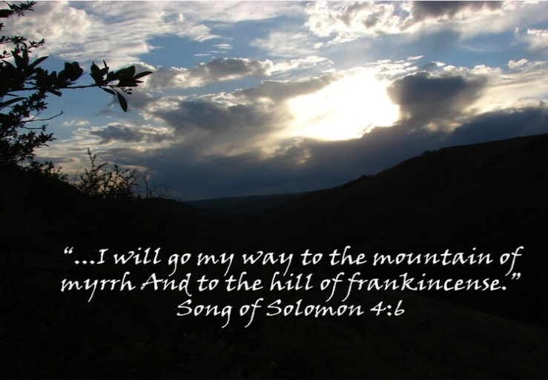
11.The shadows of night (2:17) (4:6);
Until the day breaks and the shadows flee, turn, my lover, and be like a gazelle or like a young stag on the rugged hills.(2:17)
Until the day breaks and the shadows flee, I will go to the mountain of myrrh and to the hill of incense.(4:6)

Slide 14
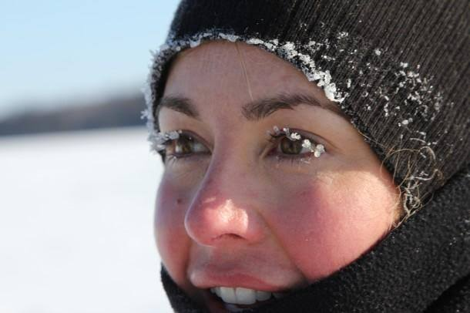
12.The season of irritation (4:6)
Until the day breaks and the shadows flee, I will go to the mountain of myrrh and to the hill of incense.(4:6)

Slide 15
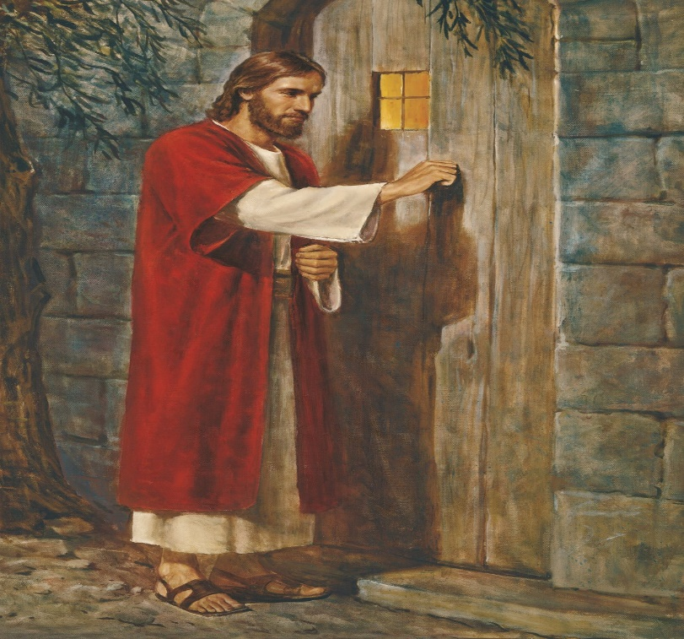
13.The season of hesitation (5:3)
I have taken off my robe- must I put it on again? I have washed my feet- must I soil them again?(5:3)

Slide 16
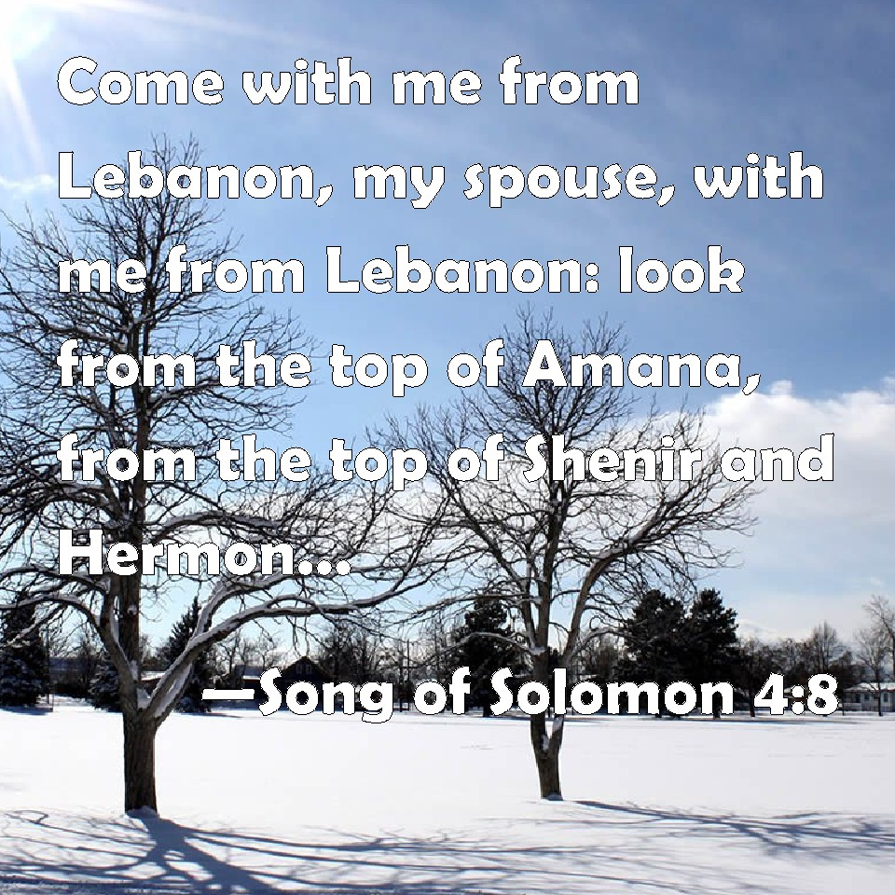
14.The lofty mountains of Leopards and Lions dens (4:8)
Come with me from Lebanon, my bride, come with me from Lebanon. Descend from the crest of Amana, from the top of Senir, the summit of Hermon, from the lions' dens and the mountain haunts of the leopards. (4:8)

Slide 17

15.The state of being sealed, enclosed and shut up (4:12)
You are a garden locked up, my sister, my bride; you are a spring enclosed, a sealed fountain. (4:12)

Slide 18
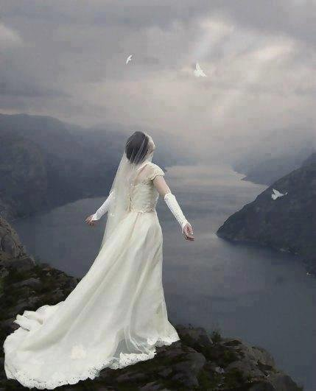
16.The state of being fainted (5:6) (2:5)
I opened for my lover, but my lover had left; he was gone. My heart sank at his departure. I looked for him but did not find him. I called him but he did not answer(5:6)
Strengthen me with raisins, refresh me with apples, for I am faint with love.(2:5)

Slide 19
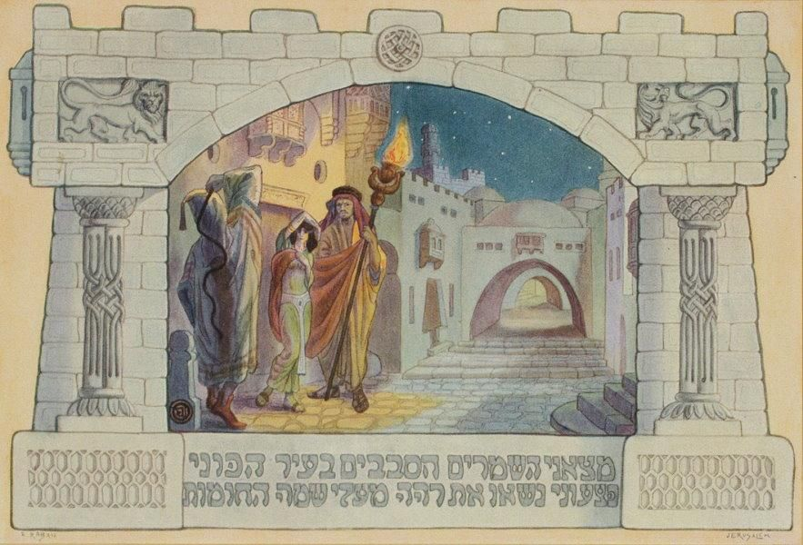
17.The hurting watchmen (5:7,8)
The watchmen found me as they made their rounds in the city. They beat me, they bruised me; they took away my cloak, those watchmen of the walls! (5:7)

Slide 20
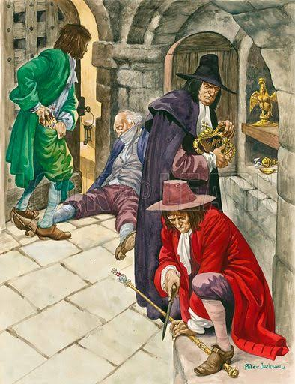
18.The stealing Keepers (5:7) ;
The watchmen found me as they made their rounds in the city. They beat me, they bruised me; they took away my cloak, those watchmen of the walls! (5:7)

Slide 21
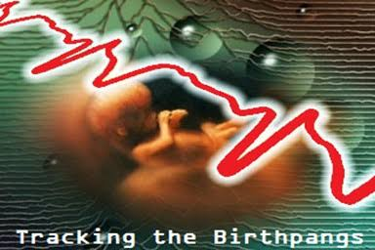
19.The season of birth pangs (8:5)
Who is this coming up from the desert leaning on her lover? Under the apple tree I roused you; there your mother conceived you, there she who was in labor gave you birth. (8:5)

Slide 22
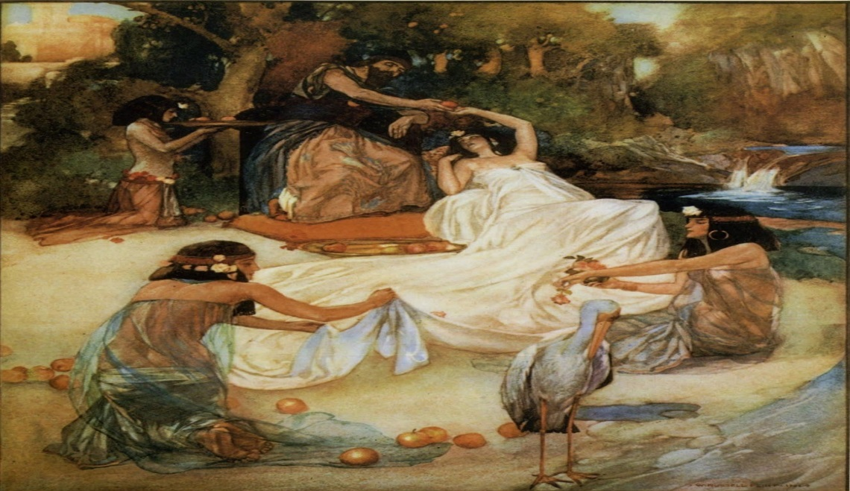
20.The deep waters (8:7)
Many waters cannot quench love; rivers cannot wash it away. If one were to give all the wealth of his house for love, it would be utterly scorned.(8:7)

Slide 23
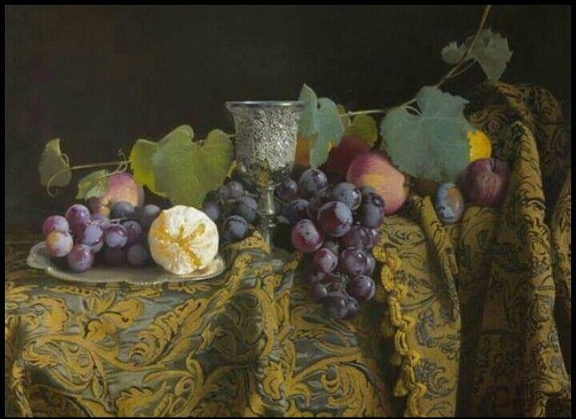
21.The unripen fruits (7:13)
The mandrakes send out their fragrance, and at our door is every delicacy, both new and old, that I have stored up for you, my lover.(7:13)

Slide 24
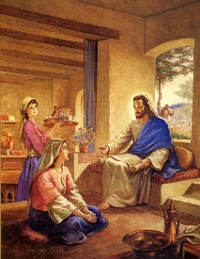
22.The immatured sister (8:8)
We have a young sister, and her breasts are not yet grown. What shall we do for our sister for the day she is spoken for? (8:8)

Slide 25
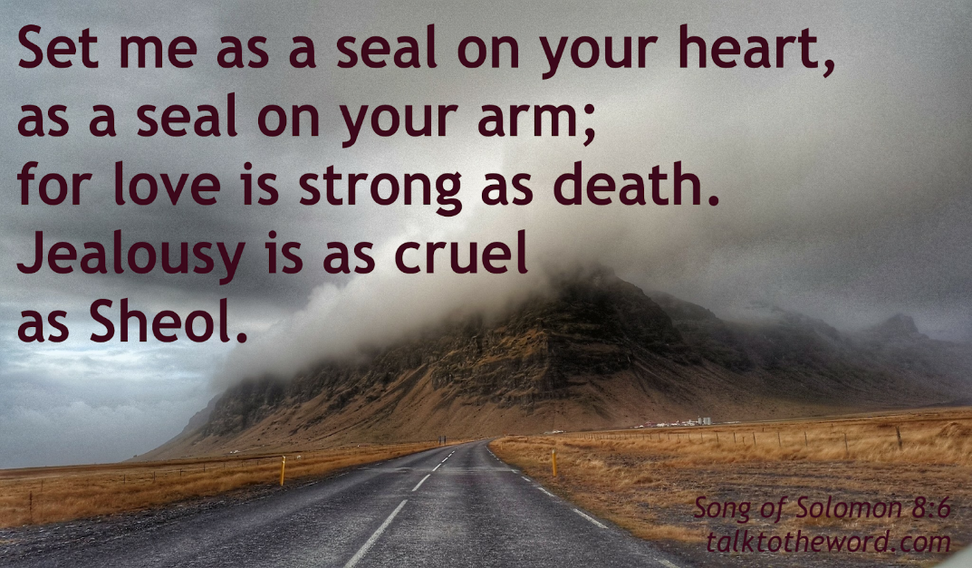
23.The raging flames (8:6)
Place me like a seal over your heart, like a seal on your arm; for love is as strong as death, its jealousy unyielding as the grave. It burns like blazing fire, like a mighty flame. (8:6)

Slide 26
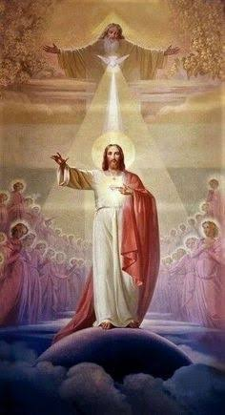
May the Holy Spirit Father Bless and Establish all of us to be His Bride.
AMEN

